Slide 1
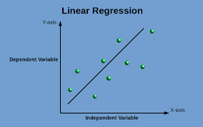
Weather Analysis in Szeged ,Hungary 2006-2016
ML using PYTHON

Slide 2
CONTENT
OBJECTIVE
TABLE ANALYSIS & CASE STUDY
EXPLANATORY DATA ANALYSIS
TREATMENTS BEFORE CREATING PREDICTIVE MODEL
PREDICTIVE MODEL BUILDING
ANALYSIS BASED ON THE PREDICTIVE MODEL
CONCLUSION

Slide 3
OBJECTIVE
The dataset is containing weather report of Szeged, near Hungary area from 2006 to 2016. The data is available in hourly response of temperature, pressure, wind speed and more. Here the object is to find relationship between the independent variables available and also to find how the independent variables are affecting the dependent continuous target variable temperature. To achieve this object linear regression machine learning technique has been used in python.

Slide 4
TABLE ANALYSIS
THE weather data of Hungary consists of 96453 rows and 12 columns.
About the columns : here are information about the weather available in these columns : Formatted date, Summary, Precip type, Temperature (in c), Apparent temperature (in c), Humidity, wind speed, Wind bearing (degree), Visibility (km), Loud cover, Pressure (millibars), Daily Summary. These attributes are available in hourly or daily basis summary.
CASE STUDY
Here temperature is the target variable which is continuous in nature, to find which independent variables are affecting it the most and by what magnitude linear regression is chosen to build predictive model on this data. How the independent variables are corelated that will be analysed as well. This machine learning model has been built using Python in Jupyter notebook.

Slide 5
EXPLANATORY DATA ANALYSIS
CATEGORICAL VARIABLE - Formatted date, Summary, Percip type, Daily Summary
Inference about the Frequency Distribution of the Numerical data :
From the frequency distribution of the numerical data we see the highest temperature is 39.9 degree Celsius and lowest is -21.8 degree Celsius. Where as for apparent temperature is max 39.3 degree Celsius and min is -27.7 degree Celsius . There is almost no Humidity in the weather of Hungary , it varies from 0 to 1 only. Wind speed is varied from 0 to 63. 85 km/h max. Wind bearing the weather is from 0 degree to 359 degrees. Maximum visibility in the weather is 16 km and minimum is 0 km. There is no loud cover in the weather. Pressure in the weather is 0 millibar to 1046.38 millibar.
NUMERICAL VARIABLES - Temperature (in c), Apparent temperature (in c), Humidity, wind speed, Wind bearing (degree), Visibility (km), Loud cover, Pressure (millibars).

Slide 6
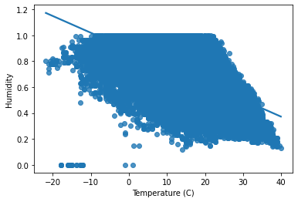
EXPLANATORY DATA ANALYSIS
Correlation between the Numerical Variables:
Humidity and temperature are negatively correlated . Here is the scatter plot of them.
Whereas humidity is also negatively correlated with apparent temperature , visibility and wind speed. Wind speed is positively correlated with temperature, wind bearing and visibility but negatively correlated with apparent temperature. Wind bearing is positively correlated with temperature, apparent temperature. Visibility is positively related with temperature and apparent temperature, pressure. Pressure is negatively correlated to temperature, apparent temperature, wind speed, wind bearing and positively correlated to visibility.

Slide 7
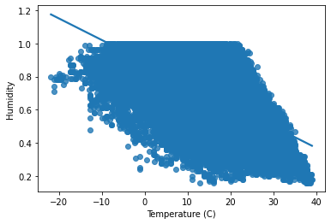
TREATMENTS BEFORE CREATING PREDICTIVE MODEL
OUTLIER IDENTIFICATION and TREATMENT: identified outliers in the data based on z score that is if z score of a data point is more than 3, it indicates that the data point is quite different from the other data point and its an outlier.
Here variable humidity had outliers in the minimum side of it and treated the outliers based on the z score . The scatterplot of correlation between humidity and temperature shows that now datapoints of humidity is free from outliers.
Outlier treated data is now ready for next steps to build predictive model on it.

Slide 8
TREATMENTS BEFORE CREATING PREDICTIVE MODEL
Created independent and dependent datasets :
Before creating predictive modelling divided the data into two data sets. One has just one variable that is the target variable Temperature (c) and named it as Y . Another contains all the independent variables available in the data that are Precip type, Apparent Temperature, Humidity. Named this dataset as X and also created dummies for the categorical variable Precip type which has two levels in it , rain and snow.
Divided the dataset into Training and Testing :
For both the datasets of independent and dependent variables, divided them into 70:30 ratio that is the training and testing dataset respectively.
VARIABLES
DEPENDENT
TEMPERATURE© (TARGET VARIABLE)
INDEPENDENT
PRECIP TYPE (LEVELS : SNOW AND RAIN)
HUMIDITY
APARENT TEMPERATURE©

Slide 9
PREDICTIVE MODEL BUILDING
Packages used in python to build the model are :
To build a linear regression model on this data first sklearn package has been used which is more oriented towards optimization part of algorithm that tries to reduce the loss function. To get an intercept term , added an constant term 1 to the train and test data. From sklearn extracted the coefficients as well.
For the train and test data fitted linear regression model to have more details about the data. This gives the summary statements containing R^2 value, adjusted R^2 value, F test, T test, AIC, BIC, DW test, skewness , kurtosis etc.
SKlearn
Statmodel.api

Slide 10
ANALYSIS BASED ON THE PREDICTIVE MODEL
MODEL TUNING
The MULTICOLNEARITY CHECK: To ensure whether the independent variables are highly corelated or not checked the VIF values dropped the variables which has VIF > 1.7 and proceeded the model for deployment.
R^2 VALUE & ADJUSTED R^2 VALUE : For the dependent variable Temperature the r square value and the adjusted r square value is 1 which describes the response variable can be properly explained by the independent variables.
F TEST: The p value of F test of dependent variable is 0.0 , the low p value indicates that we fail to accept the null hypothesis that all the coefficients are 0 and hence the model is significant.
T test : p values of all the independent variables is 0.00 , means we fail to accept the null hypothesis that coefficients of each variable is equal to 0 and each of the independent variable in the model is significant.
AIC & BIC : The very small values of these additional statistics are -1.162e+06 for both the tests which indicates a better model significance.
The Autocorrelation Check with DURBIN WATSON TEST : This test is performed to know whether the error terms are correlated or not and if they are there might be any independent variable present in the error terms. But the DW test score is 0.865 which indicates that the error terms in the linear regression doesn’t follow any pattern and they are not auto correlated.

Slide 11
ANALYSIS BASED ON THE PREDICTIVE MODEL
SKEWNESS : In the model summery -0.04 skew identifies that the data is negatively skewed that means the data has Mode > Median > Mean.
KURTOSIS : The kurtosis score of the data is 2.23 which indicates the data has lighter tails than normal distribution. This light tailed data shows the data is free from outlier problem.
Coefficients of the Independent Variables : There are 3 independent variables which we checked how they are affecting the dependent variable Temperature ©. The Apparent temperature, Precip Type_rain, Precip Type_snow has positive coefficients indicating they are positively affecting Temperature whereas Humidity has negative coefficient indicating that this variable is negatively affecting the dependent variable Temperature©. The magnitudes of the coefficients are following :
INDEPENDENT VARIABLES | COEFFICIENTS
Apparent Temperature (C) | 0.8505
Humidity | -2.7424
Precip Type_rain | 0.3868
Precip Type_snow | 0.0491

Slide 12
CONCLUSION
So it can be concluded that the model explains more than 85% confidence interval.
The temperature of Szeged ,Hungary with in 2006 to 2016 has witnessed Humidity to affect negatively. Lesser the humidity greater will be the temperature. In less temperature the humidity would be higher.
The apparent temperature or the temperature perceived by human would have positive correlation with the actual temperature. So the temperature felt by human won’t differ much from the actual temperature in Hungary area.
Rain is also positively related to temperature indicating higher rainfall would decrease the temperature in Hungary and vice versa.
Temperature and snowfall has positive correlation indicating that lesser the temperature would be , Hungary would experience greater snowfall in the weather.
So in general Hungary's weather can be concluded as hot dry summers and cold snowy winters in between 2006 to 2016.

Slide 13
THANK YOU

